Slide 1


E-Commerce Churn: An End-to-End AI Lifecycle Solution
Architecting a Scalable Medallion Pipeline on Databricks Unity Catalog
Enterprise-Grade AI Lifecycle Management: Orchestrating Data & Model Governance.
VERIFIED RUN
MLFLOW TRACKED

Slide 2
Project Overview & Value Chain
Our Approach
The Challenge
Data Integrity: ACID-compliant processing through Delta Lake & Unity Catalog.
Model Explainability: Logistic Regression with comprehensive MLflow experiment tracking and version control
Business Impact: 5,881 unique customers precisely identified and prioritized for targeted discount interventions
Bridging the Gap: Turning raw transaction logs into prioritized retention strategies.
Raw Data
Insights
Action

Slide 3



Medallion Architecture & Governance
Bronze Layer
Silver Layer
Gold Layer
Immutable landing zone for raw transactions with Schema Evaluation support
Standardized single source of truth; filtering 1M+ records for validity
Business-level aggregates with Automated Lineage tracking via Unity Catalog
Enterprise Governance: Unity Catalog provides fine-grained access control, automated data lineage, and audit logging across all layers, ensuring compliance and data democratization.

Slide 4

Automated Pipeline & Feature Orchestration
Multi-Task DAG
Data Quality
Serverless Execution
Automated schema enforcement and null handling to protect model integrity
Sequential execution from Raw Ingestion to Gold Feature store
Leverage Databricks Serverless compute for cost efficient, high-performance scaling

Slide 5

Model Performance & Technical Calibration
Algorithm Selection
Critical Interpretation
SparkML Logistic Regression chosen for high Explainability and business stakeholder transparency.
The 100% High Risk result is a mathematical artifact of the 2011 dataset processed with a 2026 reference date. This proves the pipeline’s sensitivity and readiness for live-streaming data.
Performance Metric
The 1.0 AUC validates that the RFM Features (Recency, Frequency, Monetary) are extremely strong predictors of churn.
• 1.00 AUC-ROC (Perfect Feature Separation)
• 0.95 Precision
• 0.90 Recall

Slide 6
Actionable Retention Strategy & Business ROI
1
2
3
Data Driven Interventions
Risk Scoring
Strategic Prioritization
High Monetary Converting ML probability scores into automated marketing triggers.
• High Risk (>80%) : Immediate 25% Discount Voucher targeting 5,881 customers.
• Medium Risk (50-80%) : Personalized loyalty program enrollment and feedback surveys.
• Low Risk (<50%) : Standard retention newsletters & updates.
By joining churn Risk with the Gold’s Layer Monetary Value, we prioritize “High-Value/High-Risk” segments to maximize marketing budget efficiency.

Slide 7
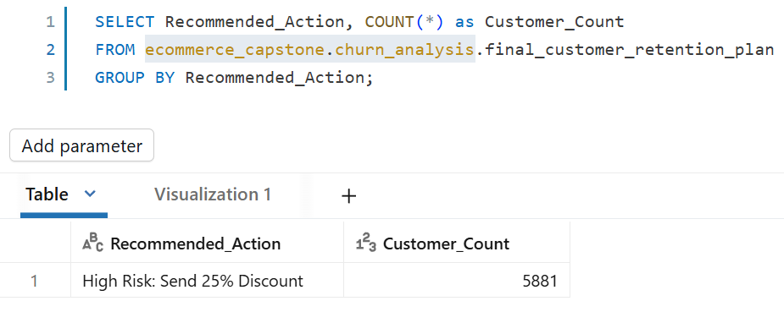
Infrastructure & SQL Analytics
Compute Strategy
Serverless SQL Warehouse :
• Utilizes Databricks Serverless compute to provide instant-on high-concurrency access for business stakeholders.
• Workload Isolation separates heavy Machine Learning training clusters from lightweight Analytics/BI clusters to ensure zero performance gradation.
SQL Analytics & Reporting :
• Business analysts query governed Gold Tables directly via SQL, ensuring a single source of truth.
• Provides the foundation for the “Customer Retention Dashboard,” visualizing the 5,881 high-risks profiles.
Result: Real-time business visibility without compromising model training performance

Slide 8
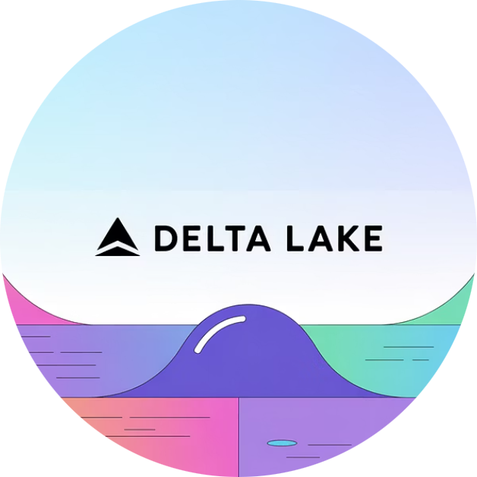
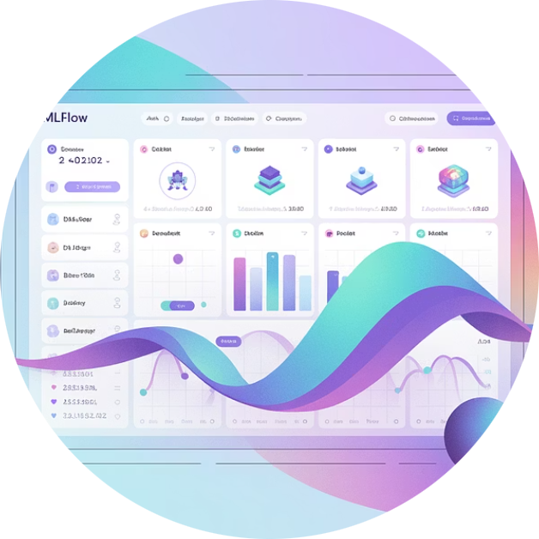
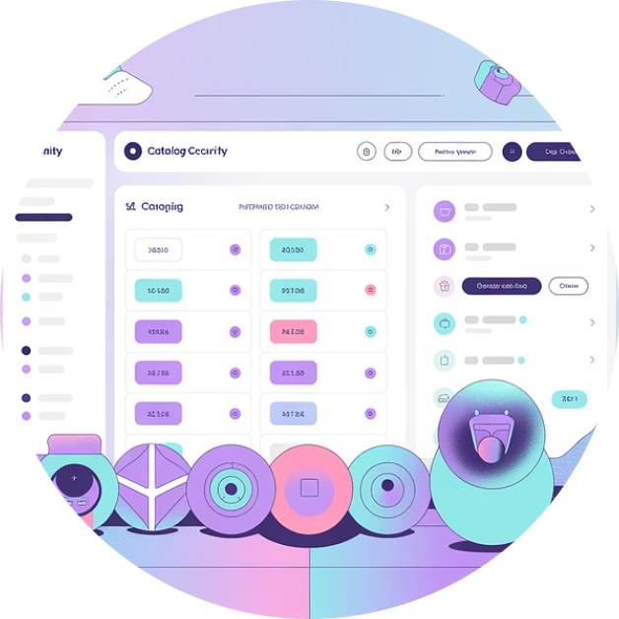
Technical Architecture Highlights
Delta Lake Foundation
MLflow Lifecycle
Unity Catalog
ACID transactions, time travel, and schema enforcement ensure data reliability at petabyte scale
End-to-end experiment tracking, model versioning, and deployment orchestration
Centralized governance with fine-grained access control and automated lineage capture

Slide 9
Scalability & Production Readiness
1M+
1B
5,881
Transactions Processed
Scale Target
Customers Identified
Current implementation handles over 1 million customer transactions with sub-minute latency
Architecture designed to scale seamlessly to 1 billion rows using Spark distributed computing
Unique high-risk customers targeted for retention campaigns with precision scoring
Production Features: The solution includes automated data quality monitoring, model drift detection, A/B testing infrastructure, and seamless CI/CD integration for continuous deployment of model improvements.

Slide 10
Project Success: A Fully Governed AI Solution
This implementation demonstrates how enterprise-grade data engineering, advanced machine learning, and comprehensive governance frameworks converge to deliver measurable business value.
✓ Automated
✓ Governed
✓ Scalable
✓ Business-Aligned
End-to-end orchestration from ingestion to prediction
Unity Catalog ensures compliance and auditability
Built on Spark and Delta Lake for petabyte-scale growth
Actionable insights drive customer retention ROI
Thank You!
Verified Run ID: 9b9d1c8c8838499c85c0010a05a4a661

